Slide 1
Rutgers Mixology The official site
Created by:
Rick Santos , Connor Reddington, & Gary Cender
Site URL:
https://gc-ru-bootcamp.github.io/RutgersMixology
Description:
The Rutgers mixology site provides, alcoholic and non-alcoholic drink listings with recipes.
The site has several search capabilities, provides recommendations and lists popular drinks.
The user can mark drinks they like and come back to them latter.
It also provides functionality to find places where to buy ingredients or get a drink made by a professional
Technology:
UI: HTML 5, CSS 3, Bootstrap 4, fonts.googleapis.com/css, pretty-checkbox.min.css, font pair
Coding: JavaScript. JQuery
APIs: Cocktail DB, geo-Location, geo-Coding, google maps

Slide 2
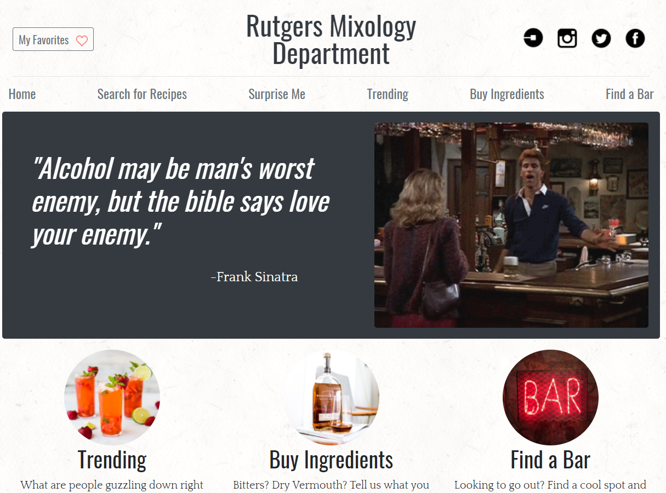
To the Demo

Slide 3
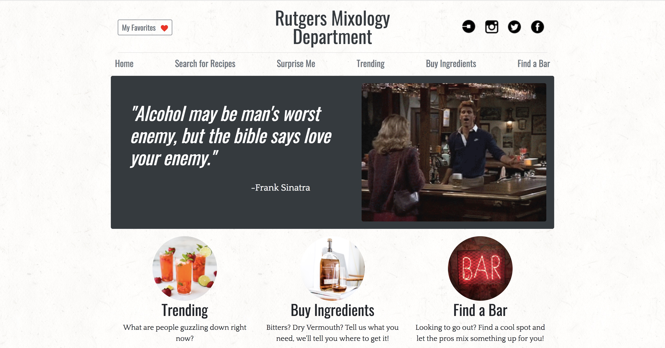
STYLING
Bootstrap, CSS, googlefonts, fontpair

Slide 4
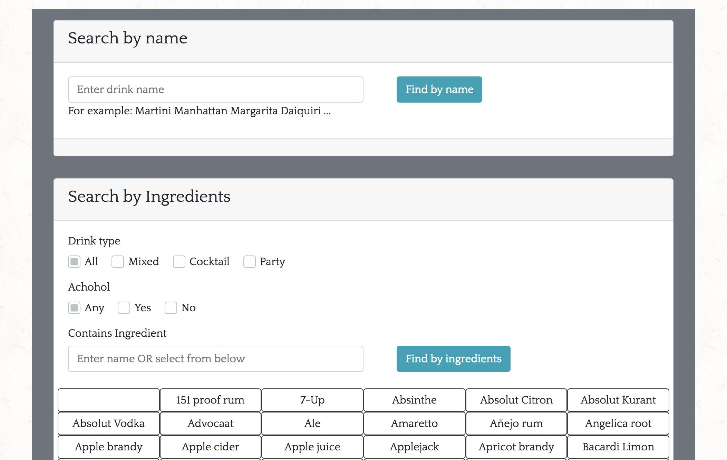
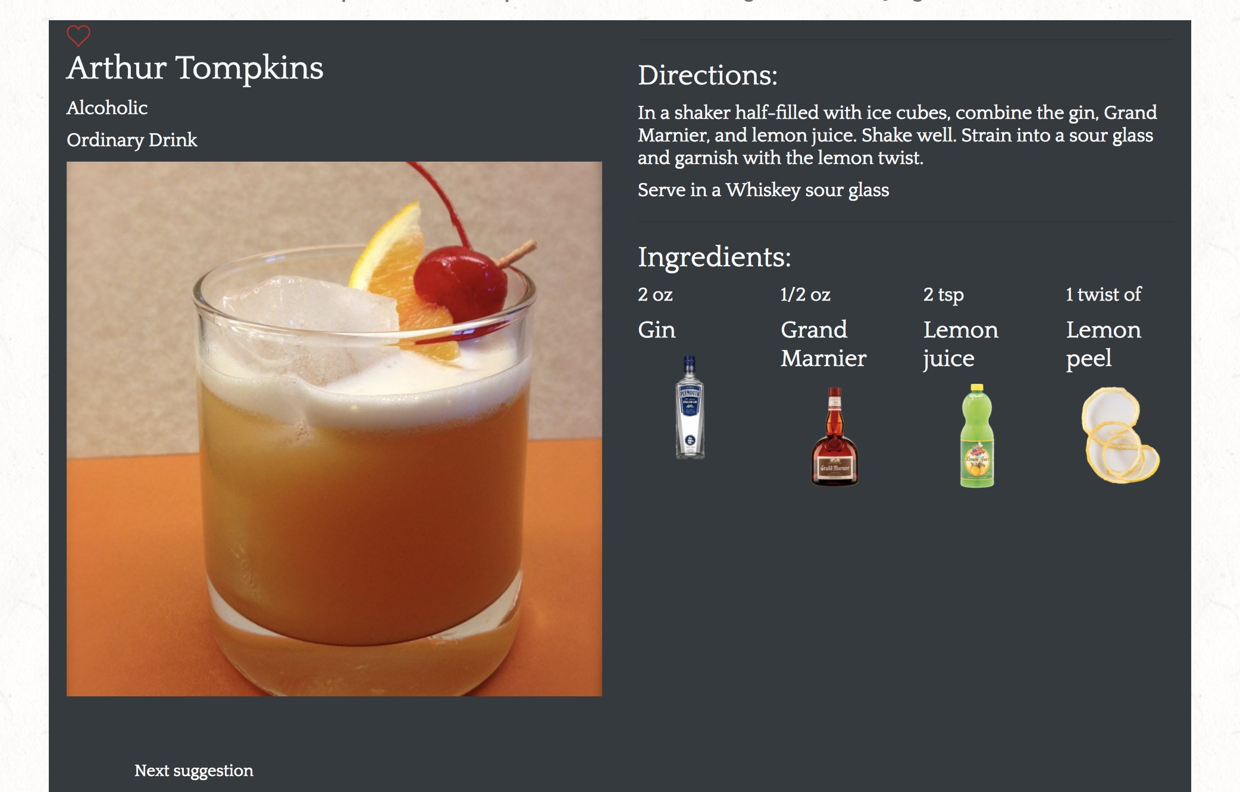
Cocktail DB

Slide 5
Google maps API
Modal Geolocation and Geocoding
Created modal on previous page. It solved the issue where the map would load the bar or liquor store locations before center location was given
Searchbox object
MyPaintMarkers function

Slide 6
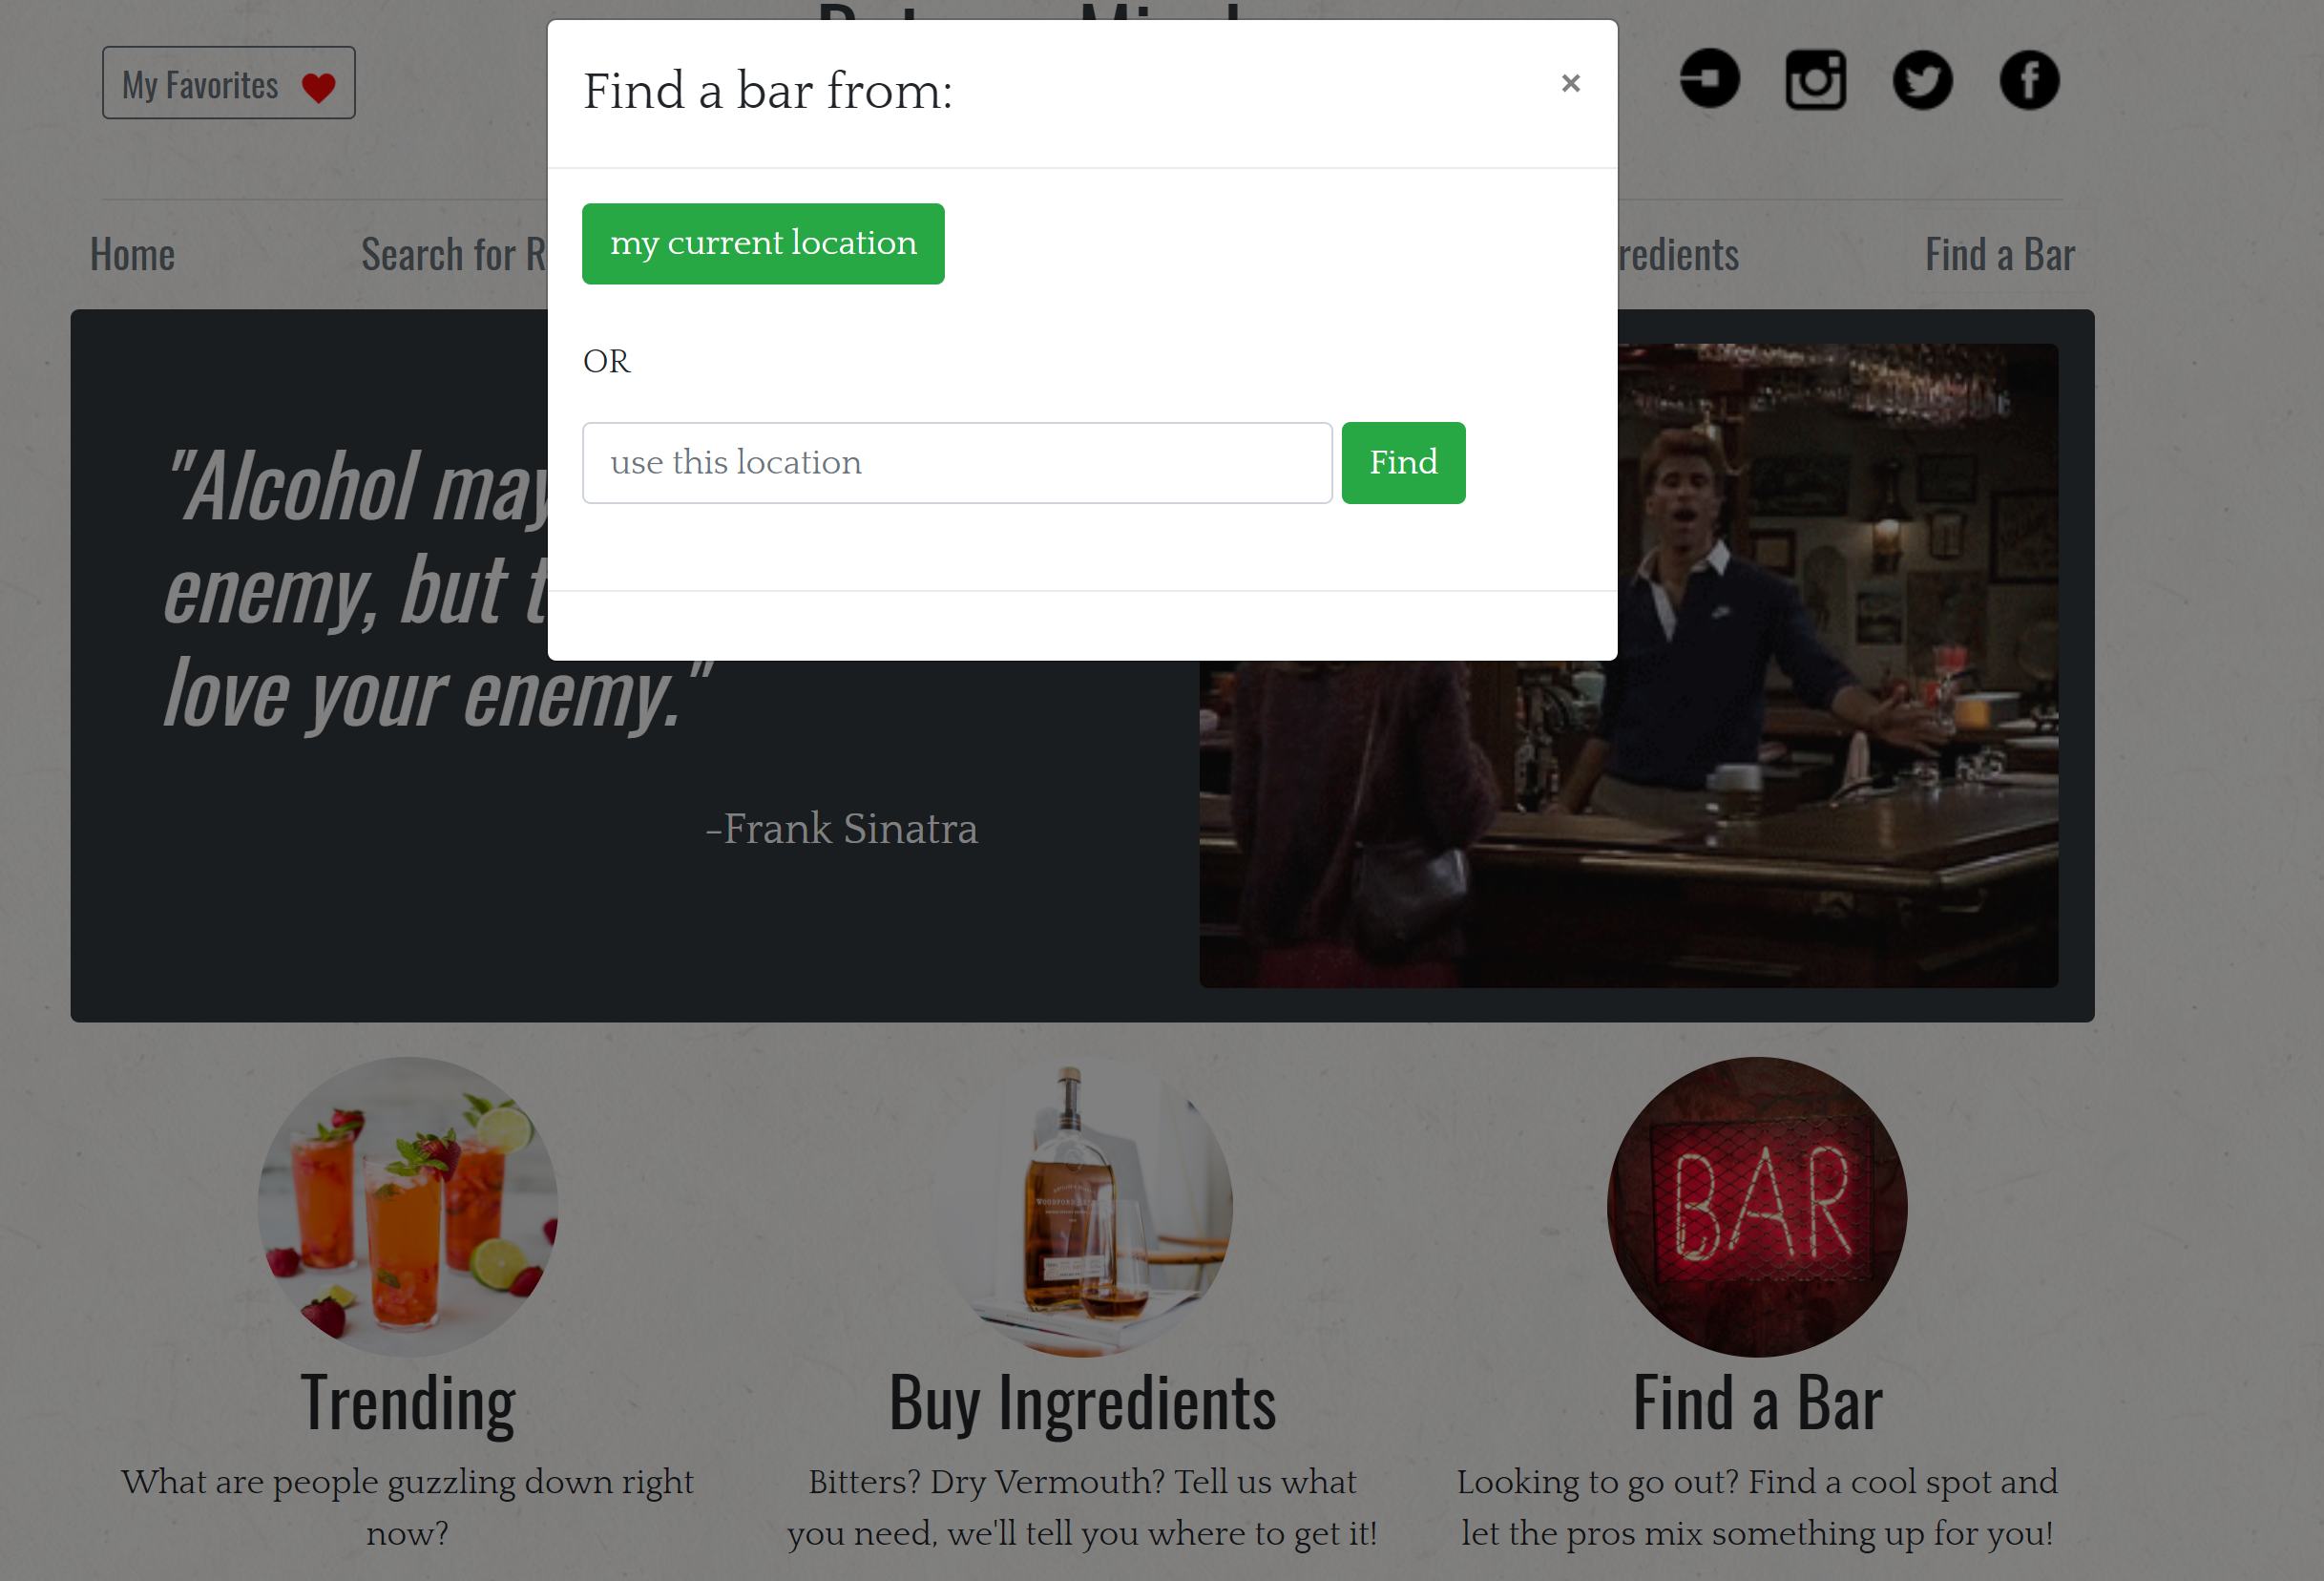
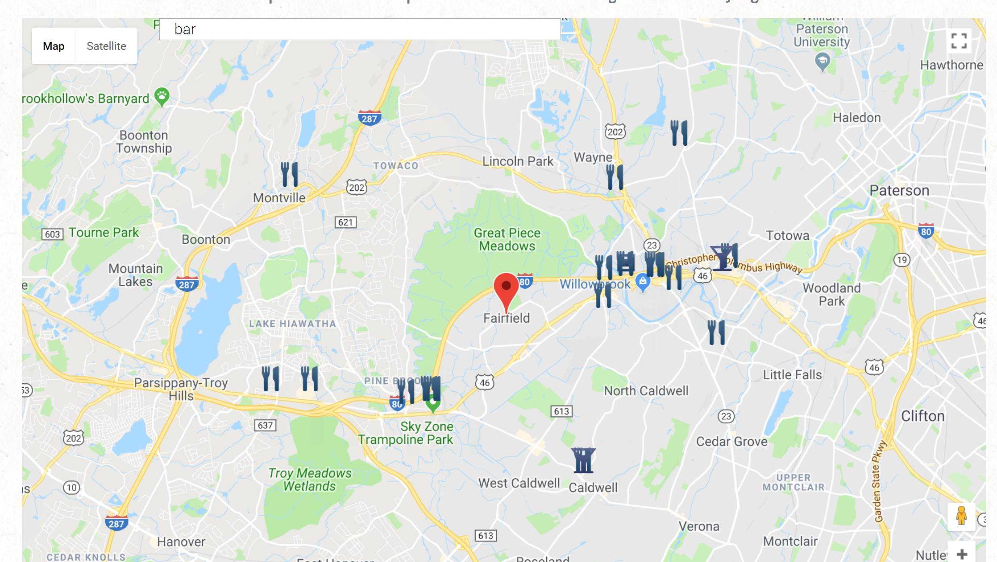
Google Maps

Slide 7
Future Development
Directions included
Expand and not only include bars but entertainment as well
Include radius options
Mouse hover to get info

